Slide 1
CHAPTER 4
LISTS
All the programs in this file are selected from
Ellis Horowitz, Sartaj Sahni, and Susan Anderson-Freed
“Fundamentals of Data Structures in C”,
Computer Science Press, 1992.
CHAPTER 4

Slide 2
Introduction
Array
successive items locate a fixed distance
disadvantage
  data movements during insertion and deletion
  waste space in storing n ordered lists of varying size
possible solution
  linked list
CHAPTER 4

Slide 3
4.1.1 Pointer Can Be Dangerous
pointer
int i, *pi;
pi = &i; i=10 or *pi=10
pi= malloc(size of(int));
/* assign to pi a pointer to int */
pf=(float *) pi;
/* casts an int pointer to a float pointer */
CHAPTER 4

Slide 4
4.1.2 Using Dynamically Allocated Storage
int i, *pi;
float f, *pf;
pi = (int *) malloc(sizeof(int));
pf = (float *) malloc (sizeof(float));
*pi =1024;
*pf =3.14;
printf(”an integer = %d, a float = %f\n”, *pi, *pf);
free(pi);
free(pf);
request memory
return memory
*Program4.1:Allocation and deallocation of pointers (p.138)
CHAPTER 4

Slide 5
4.2 SINGLY LINKED LISTS
bat •
cat •
sat •
vat NULL
*Figure 4.1: Usual way to draw a linked list (p.139)
CHAPTER 4

Slide 6
Insertion
bat •
cat •
sat •
vat NULL
mat •
*Figure 4.2: Insert mat after cat (p.140)
CHAPTER 4

Slide 7
bat •
cat •
mat •
sat •
vat NULL
dangling
reference
*Figure 4.3: Delete mat from list (p.140)
CHAPTER 4

Slide 8
typedef struct list_node, *list_pointer; typedef struct list_node { char data [4]; list_pointer link;
};
Creation list_pointer ptr =NULL;
Testing
#define IS_EMPTY(ptr) (!(ptr))
Allocation ptr=(list_pointer) malloc (sizeof(list_node));
Example 4.1: create a linked list of words
Declaration
CHAPTER 4

Slide 9
e -> name ⇨ (*e).name
strcpy(ptr -> data, “bat”);
ptr -> link = NULL;
address of
first node
ptr data
ptr link
•
b a t \0 NULL
ptr
*Figure 4.4:Referencing the fields of a node(p.142)
CHAPTER 4

Slide 10
typedef struct list_node *list_pointer; typedef struct list_node { int data; list_pointer link;
}; list_pointer ptr =NULL
Example 4.2: (p.142)
Example: create a two-node list
ptr
10 •
20 NULL
CHAPTER 4

Slide 11
list_pointer create2( )
{
/* create a linked list with two nodes */ list_pointer first, second; first = (list_pointer) malloc(sizeof(list_node)); second = ( list_pointer) malloc(sizeof(list_node)); second -> link = NULL; second -> data = 20; first -> data = 10; first ->link = second; return first;
} *Program 4.2:Create a tow-node list (p.143)
ptr
10 •
20 NULL
CHAPTER 4

Slide 12
Pointer Review (1)
int i, *pi;
1000
2000
i
?
pi
?
pi = &i;
i
1000
2000
*pi
?
pi
1000
i = 10 or *pi = 10
i
1000
2000
*pi
10
pi
1000
CHAPTER 4

Slide 13
Pointer Review (2)
typedef struct list_node *list_pointer;
typedef struct list_node {
int data;
list_pointer link;
}
list_pointer ptr = NULL;
1000
ptr
NULL
ptr->data⇨(*ptr).data
ptr = malloc(sizeof(list_node));
1000
2000
*ptr
ptr
2000
data link
CHAPTER 4

Slide 14
Pointer Review (3)
void delete(list_pointer *ptr, list_pointer trail, list_pinter node)
ptr: a pointer point to a pointer point to a list node
1000
2000
3000
ptr
2000
3000
*ptr
(*ptr)->link
trail (node): a pointer point to a list node
1000
3000
*trail
trail
3000
data link
trail->link⇨(*trail).link
CHAPTER 4

Slide 15
Pointer Review (4)
element delete(stack_pointer *top)
top
delete(&st) vs. delete(st)
st 200
300
top
200
300
200
300
400
400
.
.
.
st
top
300
300
400
Does not change.
CHAPTER 4

Slide 16
void insert(list_pointer *ptr, list_pointer node)
{
/* insert a new node with data = 50 into the list ptr after node */ list_pointer temp; temp = (list_pointer) malloc(sizeof(list_node)); if (IS_FULL(temp)){ fprintf(stderr, “The memory is full\n”); exit (1);
}
List Insertion:
Insert a node after a specific node
CHAPTER 4

Slide 17
temp->data = 50; if (*ptr) { noempty list temp->link =node ->link; node->link = temp;
} else { empty list temp->link = NULL;
*ptr =temp;
}
}
*Program 4.3:Simple insert into front of list (p.144)
ptr
10 •
20 NULL
node
50 •
temp
CHAPTER 4

Slide 18
ptr node trail = NULL ptr
10 •
50 •
20 NULL
50 •
20 NULL
(a) before deletion (b)after deletion
*Figure 4.7: List after the function call Delete(&ptr,NULL.ptr);(p.145)
CHAPTER 4

Slide 19
List Deletion
Delete the first node.
ptr trail node ptr
10 •
50 •
20 NULL
50 •
20 NULL
(a) before deletion (b)after deletion
Delete node other than the first node.
ptr trail node ptr
10 •
50 •
20 NULL
10 •
20 NULL
CHAPTER 4

Slide 20
void delete(list_pointer *ptr, list_pointer trail, list_pointer node)
{
/* delete node from the list, trail is the preceding node ptr is the head of the list */ if (trail) trail->link = node->link; else
*ptr = (*ptr) ->link; free(node);
}
trail node
10 •
50 •
20 NULL
10 •
20 NULL
ptr node ptr
10 •
50 •
20 NULL
50 •
20 NULL
CHAPTER 4

Slide 21
void print_list(list_pointer ptr)
{ printf(“The list ocntains: “); for ( ; ptr; ptr = ptr->link) printf(“%4d”, ptr->data); printf(“\n”);
}
*Program 4.5: Printing a list (p.146)
Print out a list (traverse a list)
CHAPTER 4

Slide 22
4.3 DYNAMICALLY LINKED STACKS AND QUEUES
top
element link
•
•
• • •
NULL
(a) Linked Stack
front
rear
element link
•
•
• • •
NULL
(b) Linked queue
*Figure 4.10: Linked Stack and queue (p.147)
CHAPTER 4

Slide 23
#define MAX_STACKS 10 /* maximum number of stacks */ typedef struct { int key;
/* other fields */
} element; typedef struct stack *stack_pointer; typedef struct stack { element item; stack_pointer link;
}; stack_pointer top[MAX_STACKS];
Represent n stacks
CHAPTER 4

Slide 24
#define MAX_QUEUES 10 /* maximum number of queues */ typedef struct queue *queue_pointer; typedef struct queue { element item; queue_pointer link;
}; queue_pointer front[MAX_QUEUE], rear[MAX_QUEUES];
Represent n queues
CHAPTER 4

Slide 25
void add(stack_pointer *top, element item)
{
/* add an element to the top of the stack */ stack_pointer temp =
(stack_pointer) malloc (sizeof (stack)); if (IS_FULL(temp)) { fprintf(stderr, “ The memory is full\n”); exit(1);
} temp->item = item; temp->link = *top;
*top= temp; *Program 4.6:Add to a linked stack (p.149)
}
Push in the linked stack
CHAPTER 4

Slide 26
element delete(stack_pointer *top) {
/* delete an element from the stack */ stack_pointer temp = *top; element item; if (IS_EMPTY(temp)) { fprintf(stderr, “The stack is empty\n”); exit(1);
} item = temp->item;
*top = temp->link; free(temp); return item;
}
*Program 4.7: Delete from a linked stack (p.149)
pop from the linked stack
CHAPTER 4

Slide 27
enqueue in the linked queue
void addq(queue_pointer *front, queue_pointer *rear, element item)
{ /* add an element to the rear of the queue */
queue_pointer temp =
(queue_pointer) malloc(sizeof (queue));
if (IS_FULL(temp)) {
fprintf(stderr, “ The memory is full\n”);
exit(1);
}
temp->item = item;
temp->link = NULL;
if (*front) (*rear) -> link = temp;
else *front = temp;
*rear = temp; }
CHAPTER 4

Slide 28
dequeue from the linked queue (similar to push)
element deleteq(queue_pointer *front) {
/* delete an element from the queue */
queue_pointer temp = *front;
element item;
if (IS_EMPTY(*front)) {
fprintf(stderr, “The queue is empty\n”);
exit(1);
}
item = temp->item;
*front = temp->link;
free(temp);
return item;
}
CHAPTER 4

Slide 29
Polynomials
Representation
typedef struct poly_node *poly_pointer;
typedef struct poly_node {
int coef;
int expon;
poly_pointer link;
};
poly_pointer a, b, c;
coef expon link
CHAPTER 4

Slide 30
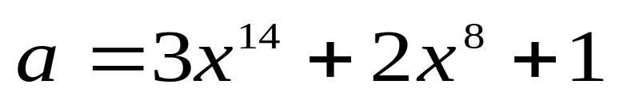
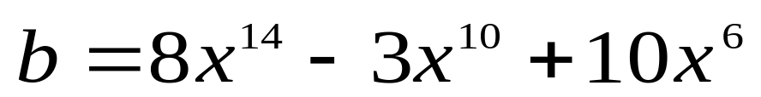
Examples
a
3 14
2 8
1 0
null
b
8 14
-3 10
10 6
null
CHAPTER 4

Slide 31
Adding Polynomials
3 14
2 8
1 0
a
8 14
-3 10
10 6
b
11 14
a->expon == b->expon
d
3 14
2 8
1 0
a
8 14
-3 10
10 6
b
11 14
-3 10
a->expon < b->expon
d
CHAPTER 4

Slide 32
Adding Polynomials (Continued)
3 14
2 8
1 0
a
8 14
-3 10
10 6
b
11 14
-3 10
2 8
d
a->expon > b->expon
CHAPTER 4

Slide 33
Alogrithm for Adding Polynomials
poly_pointer padd(poly_pointer a, poly_pointer b)
{
poly_pointer front, rear, temp;
int sum;
rear =(poly_pointer)malloc(sizeof(poly_node));
if (IS_FULL(rear)) {
fprintf(stderr, “The memory is full\n”);
exit(1);
}
front = rear;
while (a && b) {
switch (COMPARE(a->expon, b->expon)) {
CHAPTER 4

Slide 34
case -1: /* a->expon < b->expon */
attach(b->coef, b->expon, &rear);
b= b->link;
break;
case 0: /* a->expon == b->expon */
sum = a->coef + b->coef;
if (sum) attach(sum,a->expon,&rear);
a = a->link; b = b->link;
break;
case 1: /* a->expon > b->expon */
attach(a->coef, a->expon, &rear);
a = a->link;
}
}
for (; a; a = a->link)
attach(a->coef, a->expon, &rear);
for (; b; b=b->link)
attach(b->coef, b->expon, &rear);
rear->link = NULL;
temp = front; front = front->link; free(temp);
return front;
}
Delete extra initial node.
CHAPTER 4

Slide 35
Analysis
(1) coefficient additions
0 ≤ additions ≤ min(m, n)
where m (n) denotes the number of terms in A (B).
(2) exponent comparisons
extreme case
e_{m-1} > f_{m-1} > e_{m-2} > f_{m-2} > … > e₀ > f₀
m+n-1 comparisons
(3) creation of new nodes
extreme case
m + n new nodes
summary O(m+n)
CHAPTER 4

Slide 36
Attach a Term
void attach(float coefficient, int exponent,
poly_pointer *ptr)
{
/* create a new node attaching to the node pointed to
by ptr. ptr is updated to point to this new node. */
poly_pointer temp;
temp = (poly_pointer) malloc(sizeof(poly_node));
if (IS_FULL(temp)) {
fprintf(stderr, “The memory is full\n”);
exit(1);
}
temp->coef = coefficient;
temp->expon = exponent;
(*ptr)->link = temp;
*ptr = temp;
}
CHAPTER 4

Slide 37
A Suite for Polynomials
e(x) = a(x) * b(x) + d(x)
poly_pointer a, b, d, e;
...
a = read_poly();
b = read_poly();
d = read_poly();
temp = pmult(a, b);
e = padd(temp, d);
print_poly(e);
read_poly()
print_poly()
padd()
psub()
pmult()
temp is used to hold a partial result.
By returning the nodes of temp, we
may use it to hold other polynomials
CHAPTER 4

Slide 38
Erase Polynomials
void earse(poly_pointer *ptr)
{
/* erase the polynomial pointed to by ptr */
poly_pointer temp;
while (*ptr) {
temp = *ptr;
*ptr = (*ptr)->link;
free(temp);
}
}
O(n)
CHAPTER 4

Slide 39
Circularly Linked Lists
circular list vs. chain
ptr
3 14
2 8
1 0
avail
ptr
temp
avail
...
CHAPTER 4

Slide 40
Maintain an Available List
poly_pointer get_node(void)
{
poly_pointer node;
if (avail) {
node = avail;
avail = avail->link:
}
else {
node = (poly_pointer)malloc(sizeof(poly_node));
if (IS_FULL(node)) {
printf(stderr, “The memory is full\n”);
exit(1);
}
}
return node;
}
CHAPTER 4

Slide 41
Maintain an Available List (Continued)
Insert ptr to the front of this list
void ret_node(poly_pointer ptr)
{
ptr->link = avail;
avail = ptr;
}
void cerase(poly_pointer *ptr)
{
poly_pointer temp;
if (*ptr) {
temp = (*ptr)->link;
(*ptr)->link = avail;
avail = temp;
*ptr = NULL;
}
}
Erase a circular list (see next page)
(1)
(2)
Independent of # of nodes in a list O(1) constant time
CHAPTER 4

Slide 42
4.4.4 Representing Polynomials As Circularly Linked Lists
avail
(2)
•
•
• • •
•
ptr
(1)
temp
•
•
• • •
NULL
avail
*Figure 4.14: Returning a circular list to the avail list (p.159)
CHAPTER 4

Slide 43
Head Node
Represent polynomial as circular list.
(1) zero
a
-1
Zero polynomial
(2) others
a
-1
3 14
2 8
1 0
CHAPTER 4

Slide 44
Another Padd
poly_pointer cpadd(poly_pointer a, poly_pointer b)
{
poly_pointer starta, d, lastd;
int sum, done = FALSE;
starta = a;
a = a->link;
b = b->link;
d = get_node();
d->expon = -1; lastd = d;
do {
switch (COMPARE(a->expon, b->expon)) {
case -1: attach(b->coef, b->expon, &lastd);
b = b->link;
break;
Set expon field of head node to -1.
CHAPTER 4

Slide 45
Another Padd (Continued)
case 0: if (starta == a) done = TRUE;
else {
sum = a->coef + b->coef;
if (sum) attach(sum,a->expon,&lastd);
a = a->link; b = b->link;
}
break;
case 1: attach(a->coef,a->expon,&lastd);
a = a->link;
}
} while (!done);
lastd->link = d;
return d;
}
Link last node to first
CHAPTER 4

Slide 46
Additional List Operations
typedef struct list_node *list_pointer;
typedef struct list_node {
char data;
list_pointer link;
};
Invert single linked lists
Concatenate two linked lists
CHAPTER 4

Slide 47
Invert Single Linked Lists
Use two extra pointers: middle and trail.
list_pointer invert(list_pointer lead)
{
list_pointer middle, trail;
middle = NULL;
while (lead) {
trail = middle;
middle = lead;
lead = lead->link;
middle->link = trail;
}
return middle;
}
0: null
1: lead
≥2: lead
...
CHAPTER 4

Slide 48
Concatenate Two Lists
list_pointer concatenate(list_pointer
ptr1, list_pointer ptr2)
{
list_pointer temp;
if (IS_EMPTY(ptr1)) return ptr2;
else {
if (!IS_EMPTY(ptr2)) {
for (temp=ptr1;temp->link;temp=temp->link);
temp->link = ptr2;
}
return ptr1;
}
}
O(m) where m is # of elements in the first list
CHAPTER 4

Slide 49
4.5.2 Operations For Circularly Linked List
What happens when we insert a node to the front of a circular
linked list?
a
X₁ •
X₂ •
X₃ •
Problem: move down the whole list.
*Figure 4.16: Example circular list (p.165)
CHAPTER 4

Slide 50
A possible solution:
X₁ •
X₂ •
X₃ •
a
Note a pointer points to the last node.
*Figure 4.17: Pointing to the last node of a circular list (p.165)
CHAPTER 4

Slide 51
Operations for Circular Linked Lists
void insert_front (list_pointer *ptr, list_pointer node)
{
if (IS_EMPTY(*ptr)) {
*ptr= node;
node->link = node;
}
else {
node->link = (*ptr)->link; (1)
(*ptr)->link = node; (2)
}
}
(2)
X₁ •
X₂ •
X₃ •
ptr
(1)
CHAPTER 4

Slide 52
Length of Linked List
int length(list_pointer ptr)
{
list_pointer temp;
int count = 0;
if (ptr) {
temp = ptr;
do {
count++;
temp = temp->link;
} while (temp!=ptr);
}
return count;
}
CHAPTER 4

Slide 53
Equivalence Relations
A relation over a set, S, is said to be an equivalence relation over S iff it is symmertric, reflexive, and transitive over S.
  reflexive, x=x
  symmetric, if x=y, then y=x
  transitive, if x=y and y=z, then x=z
CHAPTER 4

Slide 54
Examples
0=4, 3=1, 6=10, 8=9, 7=4,
6=8, 3=5, 2=11, 11=1
three equivalent classes
{0,2,4,7,11}; {1,3,5}; {6,8,9,10}
CHAPTER 4

Slide 55
A Rough Algorithm to
Find Equivalence Classes
void equivalenec()
{
initialize;
while (there are more pairs) {
read the next pair <i,j>;
process this pair;
}
initialize the output;
do {
output a new equivalence class;
} while (not done);
}
Phase 1
Phase 2
What kinds of data structures are adopted?
CHAPTER 4

Slide 56
First Refinement
#include <stdio.h>
#include <alloc.h>
#define MAX_SIZE 24
#define IS_FULL(ptr) (!(ptr))
#define FALSE 0
#define TRUE 1
void equivalence()
{
initialize seq to NULL and out to TRUE
while (there are more pairs) {
read the next pair, <i,j>;
put j on the seq[i] list;
put i on the seq[j] list;
}
for (i=0; i<n; i++)
if (out[i]) {
out[i]= FALSE;
output this equivalence class;
}
}
direct equivalence
Compute indirect equivalence
using transitivity
CHAPTER 4

Slide 57
Lists After Pairs are input
[0] [1] [2] [3] [4] [5] [6] [7] [8] [9] [10] [11]
0 ≡ 4
3 ≡ 1
6 ≡ 10
8 ≡ 9
7 ≡ 4
6 ≡ 8
3 ≡ 5
2 ≡ 11
11 ≡ 0
seq
11
3
11
5
7
3
8
4
6
8
6
0
NULL
NULL
NULL
NULL
NULL
NULL
4
1
0
10
9
2
NULL
NULL
NULL
NULL
NULL
NULL
typedef struct node *node_pointer ;
typedef struct node {
int data;
node_pointer link;
};
CHAPTER 4

Slide 58
Final Version for
Finding Equivalence Classes
void main(void)
{
short int out[MAX_SIZE];
node_pointer seq[MAX_SIZE];
node_pointer x, y, top;
int i, j, n;
printf(“Enter the size (<= %d) “, MAX_SIZE);
scanf(“%d”, &n);
for (i=0; i<n; i++) {
out[i]= TRUE; seq[i]= NULL;
}
printf(“Enter a pair of numbers (-1 -1 to quit): “);
scanf(“%d%d”, &i, &j);
Phase 1: input the equivalence pairs:
CHAPTER 4

Slide 59
while (i>=0) {
x = (node_pointer) malloc(sizeof(node));
if (IS_FULL(x))
fprintf(stderr, “memory is full\n”);
exit(1);
}
x->data= j; x->link= seq[i]; seq[i]= x;
if (IS_FULL(x))
fprintf(stderr, “memory is full\n”);
exit(1);
}
x->data= i; x->link= seq[j]; seq[j]= x;
printf(“Enter a pair of numbers (-1 -1 to \
quit): “);
scanf(“%d%d”, &i, &j);
}
Insert x to the top of lists seq[i]
Insert x to the top of lists seq[j]
CHAPTER 4

Slide 60
Phase 2: output the equivalence classes
for (i=0; i<n; i++) {
if (out[i]) {
printf(“\nNew class: %5d”, i);
out[i]= FALSE;
x = seq[i]; top = NULL;
for (;;) {
while (x) {
j = x->data;
if (out[j]) {
printf(“%5d”, j);
out[j] = FALSE;
y = x->link; x->link = top;
top = x; x = y;
}
else x = x->link;
}
if (!top) break;
x = seq[top->data]; top = top->link;
}
}
}
push
pop
CHAPTER 4

Slide 61
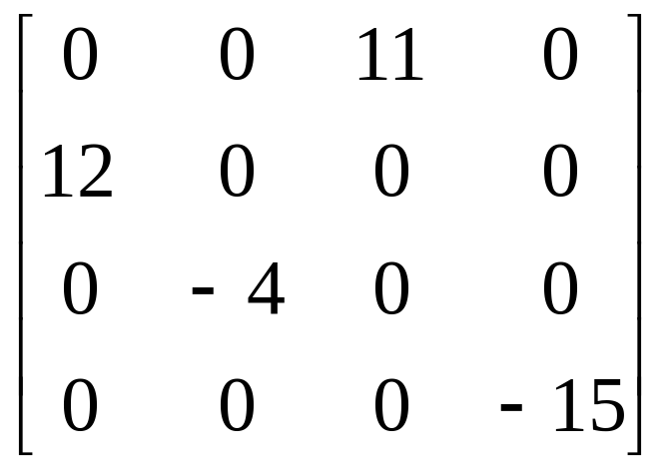
4.7 Sparse Matrices
inadequates of sequential schemes
(1) # of nonzero terms will vary after some matrix computation
(2) matrix just represents intermediate results
new scheme
Each column (row): a circular linked list with a head node
CHAPTER 4

Slide 62
Revisit Sparse Matrices
# of head nodes = max{# of rows, # of columns}
連同一行元素
down
head
right
連同一列元素
head node
next
down
entry
row
col
right
entry node
value
entry
i
j
aij
aij
CHAPTER 4

Slide 63
Linked Representation for Matrix
4
4
0
2
11
1
0
1
1
12
5
2
1
-4
3
3
-15
Circular linked list
CHAPTER 4

Slide 64
#define MAX_SIZE 50 /* size of largest matrix */ typedef enum {head, entry} tagfield; typedef struct matrix_node *matrix_pointer; typedef struct entry_node { int row; int col; int value;
}; typedef struct matrix_node { matrix_pointer down; matrix_pointer right; tagfield tag;
CHAPTER 4

Slide 65
union { matrix_pointer next; entry_node entry;
} u;
}; matrix_pointer hdnode[MAX_SIZE];
CHAPTER 4

Slide 66
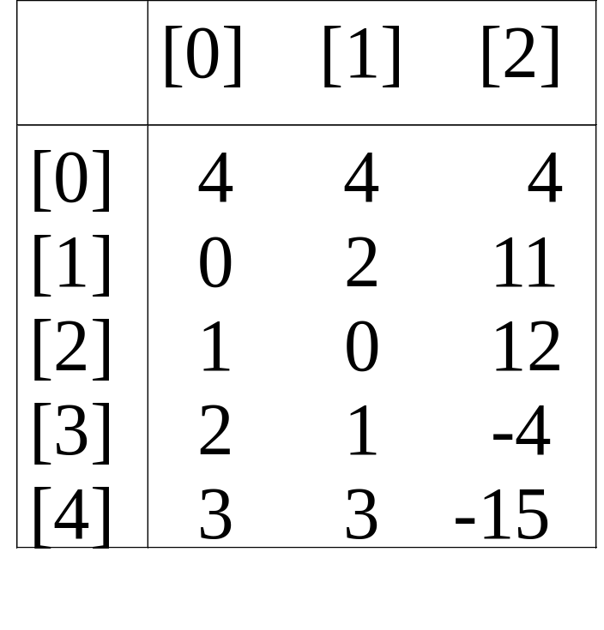
*Figure 4.22: Sample input for sparse matrix (p.174)
CHAPTER 4

Slide 67
Read in a Matrix
matrix_pointer mread(void)
{
/* read in a matrix and set up its linked
list. An global array hdnode is used */
int num_rows, num_cols, num_terms;
int num_heads, i;
int row, col, value, current_row;
matrix_pointer temp, last, node;
printf(“Enter the number of rows, columns
and number of nonzero terms: “);
CHAPTER 4

Slide 68
scanf(“%d%d%d”, &num_rows, &num_cols,
&num_terms);
num_heads =
(num_cols>num_rows)? num_cols : num_rows;
/* set up head node for the list of head
nodes */
node = new_node(); node->tag = entry;
node->u.entry.row = num_rows;
node->u.entry.col = num_cols;
if (!num_heads) node->right = node;
else { /* initialize the head nodes */
for (i=0; i<num_heads; i++) {
term= new_node();
hdnode[i] = temp;
hdnode[i]->tag = head;
hdnode[i]->right = temp;
hdnode[i]->u.next = temp;
}
O(max(n,m))
CHAPTER 4

Slide 69
current_row= 0; last= hdnode[0];
for (i=0; i<num_terms; i++) {
printf(“Enter row, column and value:”);
scanf(“%d%d%d”, &row, &col, &value);
if (row>current_row) {
last->right= hdnode[current_row];
current_row= row; last=hdnode[row];
}
temp = new_node();
temp->tag=entry; temp->u.entry.row=row;
temp->u.entry.col = col;
temp->u.entry.value = value;
last->right = temp;/*link to row list */
last= temp;
/* link to column list */
hdnode[col]->u.next->down = temp;
hdnode[col]=>u.next = temp;
}
...
利用next field 存放column的last node
CHAPTER 4

Slide 70
/*close last row */
last->right = hdnode[current_row];
/* close all column lists */
for (i=0; i<num_cols; i++)
hdnode[i]->u.next->down = hdnode[i];
/* link all head nodes together */
for (i=0; i<num_heads-1; i++)
hdnode[i]->u.next = hdnode[i+1];
hdnode[num_heads-1]->u.next= node;
node->right = hdnode[0];
}
return node;
}
O(max{#_rows, #_cols}+#_terms)
CHAPTER 4

Slide 71
Write out a Matrix
void mwrite(matrix_pointer node)
{ /* print out the matrix in row major form */
int i;
matrix_pointer temp, head = node->right;
printf(“\n num_rows = %d, num_cols= %d\n”,
node->u.entry.row,node->u.entry.col);
printf(“The matrix by row, column, and
value:\n\n”);
for (i=0; i<node->u.entry.row; i++) {
for (temp=head->right;temp!=head;temp=temp->right)
printf(“%5d%5d%5d\n”, temp->u.entry.row,
temp->u.entry.col, temp->u.entry.value);
head= head->u.next; /* next row */
}
}
O(#_rows+#_terms)
CHAPTER 4

Slide 72
Free the entry and head nodes by row.
Erase a Matrix
void merase(matrix_pointer *node)
{
int i, num_heads;
matrix_pointer x, y, head = (*node)->right;
for (i=0; i<(*node)->u.entry.row; i++) {
y=head->right;
while (y!=head) {
x = y; y = y->right; free(x);
}
x= head; head= head->u.next; free(x);
}
y = head;
while (y!=*node) {
x = y; y = y->u.next; free(x);
}
free(*node); *node = NULL;
}
O(#_rows+#_cols+#_terms)
Alternative: 利用Fig 4.14的技巧，把一列資料erase (constant time)
CHAPTER 4

Slide 73
Doubly Linked List
Move in forward and backward direction.
Singly linked list (in one direction only)
How to get the preceding node during deletion or insertion?
Using 2 pointers
Node in doubly linked list
left link field (llink)
data field (item)
right link field (rlink)
CHAPTER 4

Slide 74
Doubly Linked Lists
typedef struct node *node_pointer;
typedef struct node {
node_pointer llink;
element item;
node_pointer rlink;
}
ptr
= ptr->rlink->llink
= ptr->llink->rlink
head node
llink item rlink
CHAPTER 4

Slide 75
ptr
*Figure 4.24:Empty doubly linked circular list with head node (p.180)
CHAPTER 4

Slide 76
node
node
• •
newnode
*Figure 4.25: Insertion into an empty doubly linked circular list (p.181)
CHAPTER 4

Slide 77
Insert
void dinsert(node_pointer node, node_pointer newnode)
{
(1) newnode->llink = node;
(2) newnode->rlink = node->rlink;
(3) node->rlink->llink = newnode;
(4) node->rlink = newnode;
}
head node
llink item rlink
(1)
(3)
(4)
(2)
CHAPTER 4

Slide 78
Delete
void ddelete(node_pointer node, node_pointer deleted)
{
if (node==deleted) printf(“Deletion of head node
not permitted.\n”);
else {
(1) deleted->llink->rlink= deleted->rlink;
(2) deleted->rlink->llink= deleted->llink;
free(deleted);
}
}
head node
(1)
llink item rlink
(2)
CHAPTER 4

